Slide 1



Data and Information Management
CBI business discussion

Slide 2
Definition of Data
Data is defined as a collection of individual facts or statistics.
Quantitative data is provided in numerical form
Qualitative data is descriptive, but non-numerical

Slide 3
Data Management
Targets & collection.
Test reliability of sources
Gap Analysis, Adjustments &
Quality assessment
Meta data informs
integrity and security

Slide 4
Data Accessibility
In a recent survey, data was requested from 516 studies that were published between 2 and 22 years earlier, but less than 1 out of 5 of these studies were able or willing to provide the requested data. Overall, the likelihood of retrieving data dropped by 17% each year after publication.
https://en.wikipedia.org/wiki/Data
Develop and maintain your own database.
Due to the cost of the investment to research, few are willing to share
Fear of losing the competitive advantage
High likelihood of an imperfect match

Slide 5
Concept of FAIR Data
Findable data
Accessible data
Interoperable data
Reusable data

Slide 6
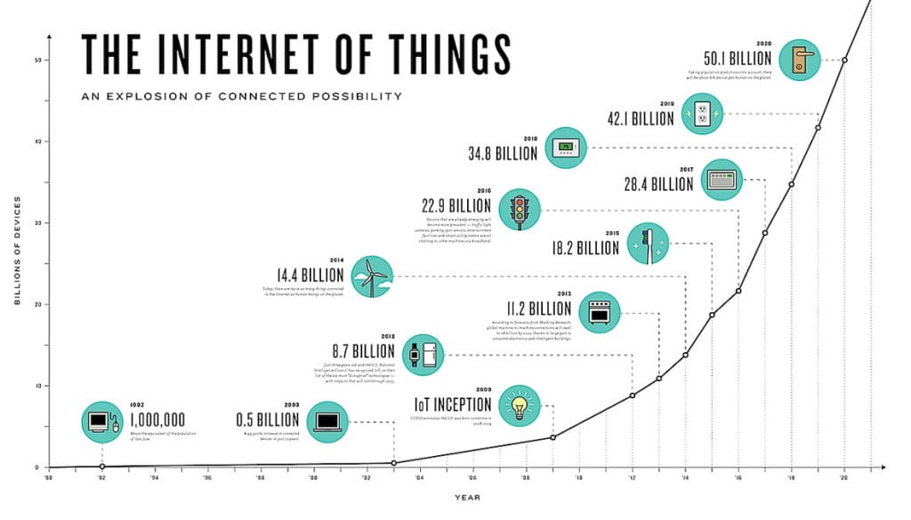
Concept of FAIR Data
Findable data
Accessible data
Interoperable data
Reusable data

Slide 7
30+ Free data sources
Link: https://www.webfx.com/blog/marketing/data-sources/
Amazon Web Services – 348 matching data sets
Data Portals – 590 international data sets
Pew Research Centre - https://www.pewresearch.org/about/
Statista – 170 Industries 150+ countries
Big gap developing in reliable data sources in South Africa

Slide 8
Definition of Information
Information is the result of analysing and interpreting data.
Information is the result of contextualization and perception
of factual knowledge used for decision making.

Slide 9
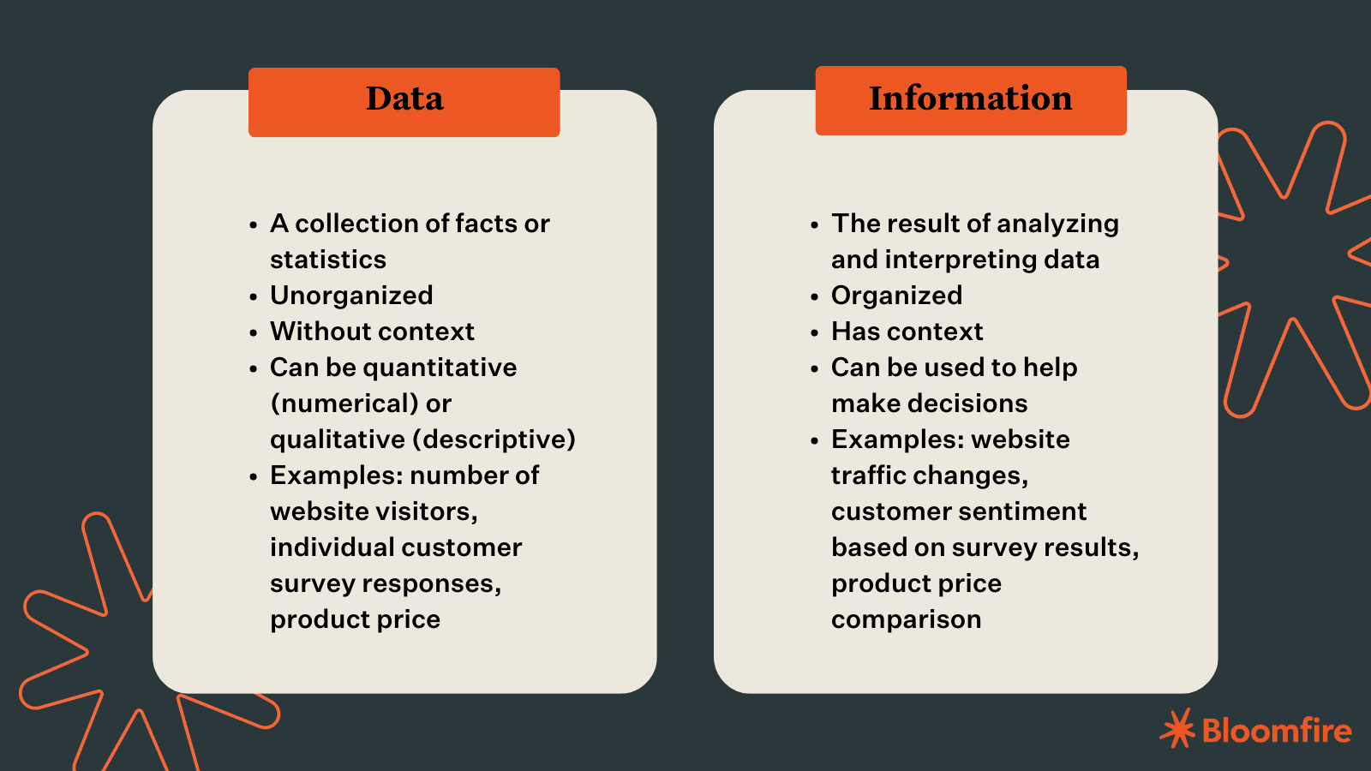
Definition of Data

Slide 10
Local information sources
Stats SA
Link: https://www.statssa.gov.za/
https://www.tshwane.gov.za/?page_id=40320
Bureau of Market Research (Blog)
https://bmr.co.za/
City of Tshwane: Integrated Development Plans (Region 6)

Slide 11
Macro Economic Indicators
Gross Domestic Product (GDP) – Measure of countries output and productivity
Inflation – Impacts on the purchasing power of the currency
Unemployment rate - Indication of a community’s spending potential or demand
Gross National Income (GNI) – Indication of economic growth per capita.

Slide 12
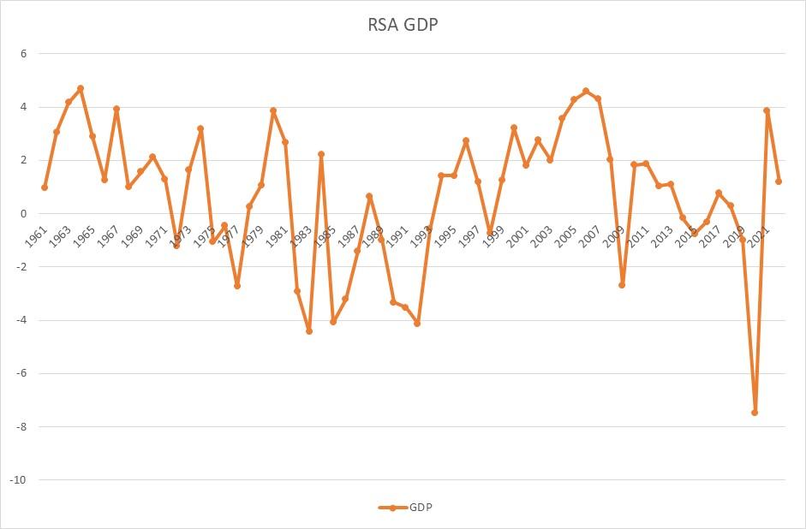
GDP 1961-2022
GDP effectively
declined @ 0,3%/a
since 1961
World bank data

Slide 13
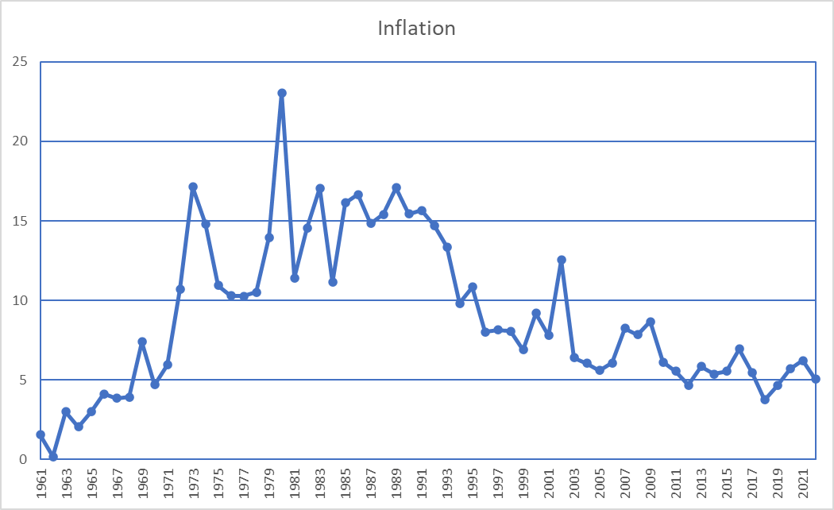
Inflation rate
The average annual
Rate of inflation was
5,99% since 2003.
We became poorer
a rate of 2,59%/a/c
6%
World bank data

Slide 14
CPI Basket check 2023

Slide 15
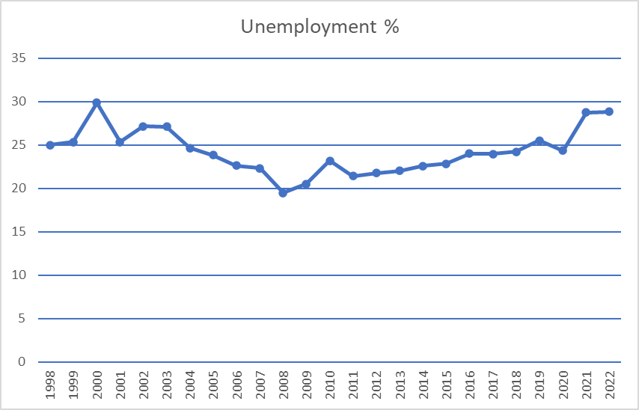
Unemployment Rate (%)
>20% for 24 years
Steadily increasing
since 2008
World bank data

Slide 16
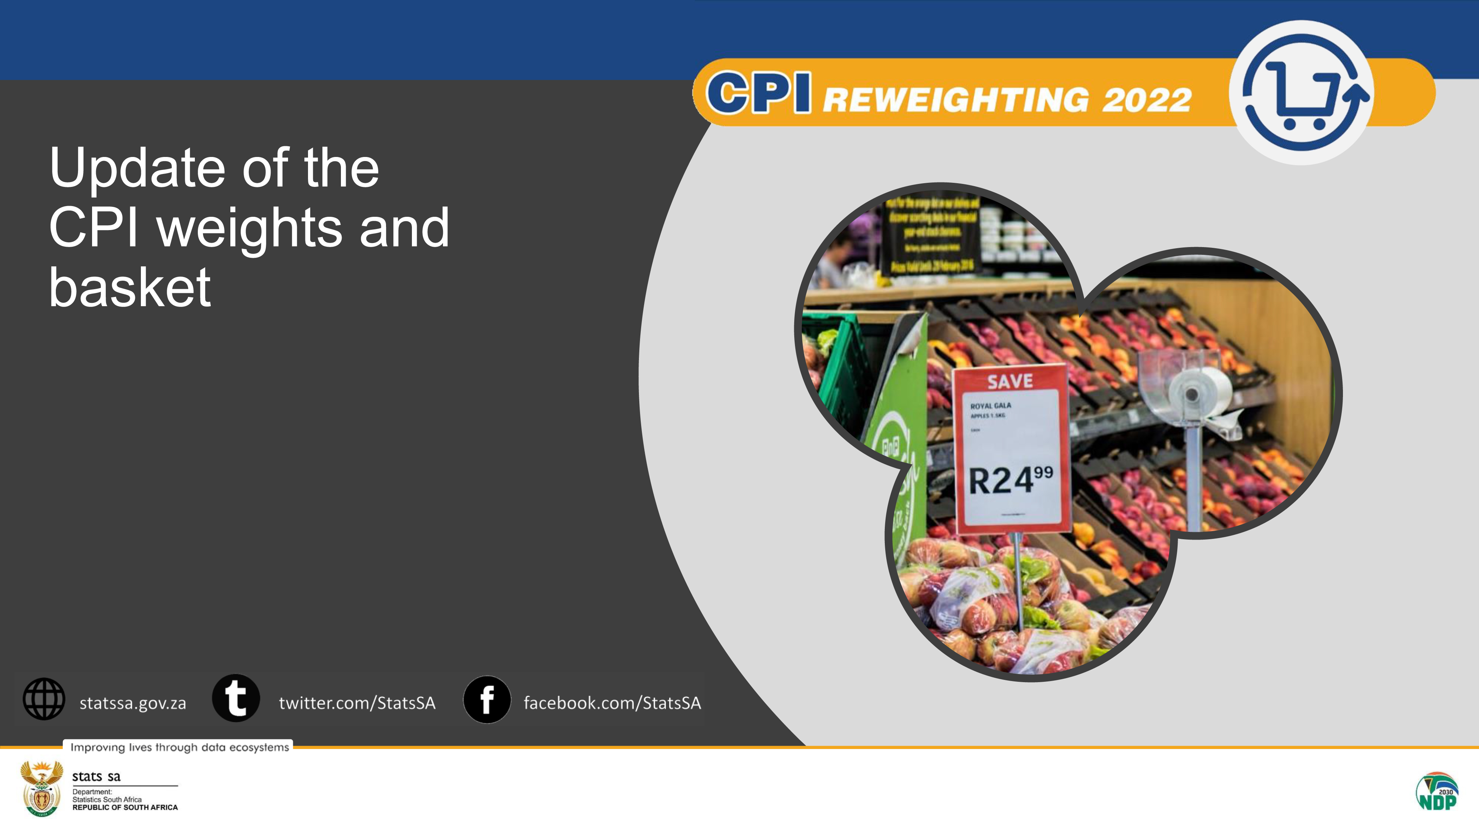
CPI
StatsSA

Slide 17
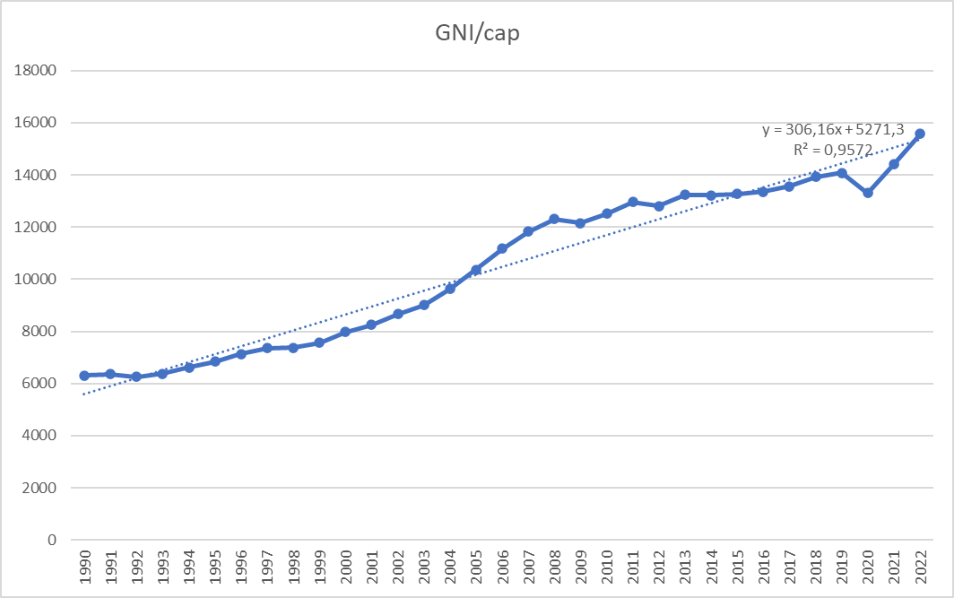
GNI per capita
Indicative linear growth rate of 3,4% /c/a (less than inflation)
World bank data
World bank data

Slide 18
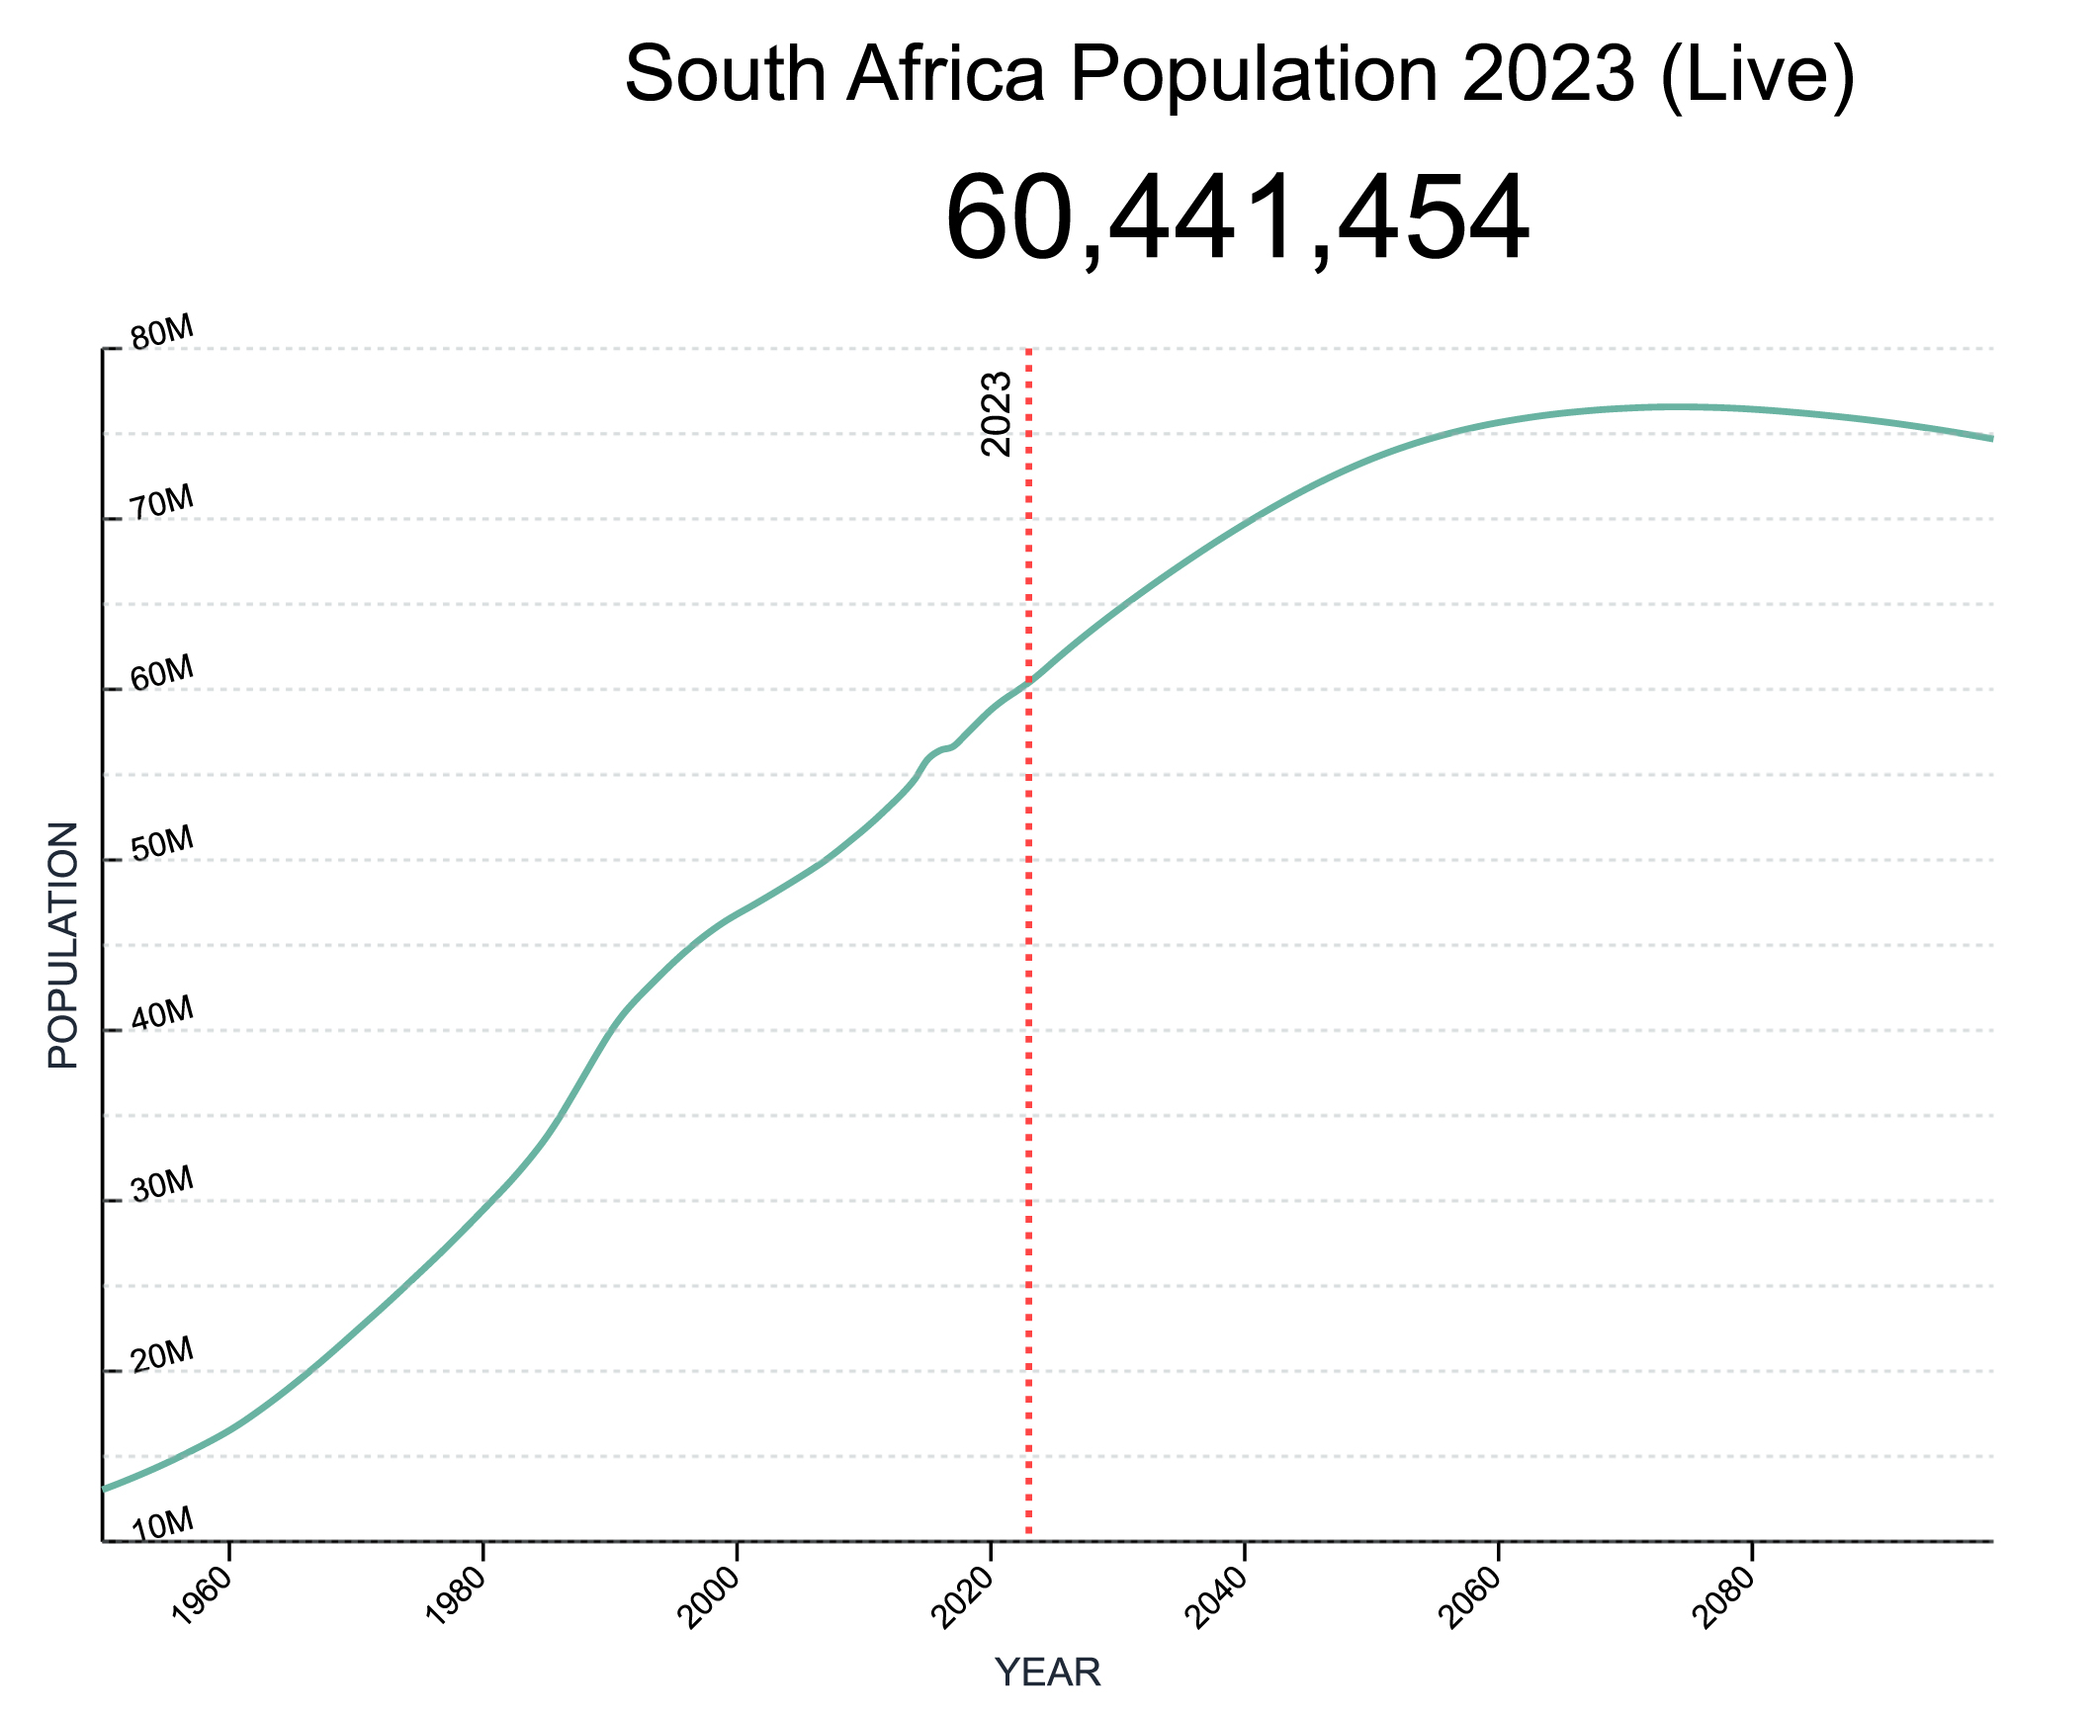
National population growth

Slide 19
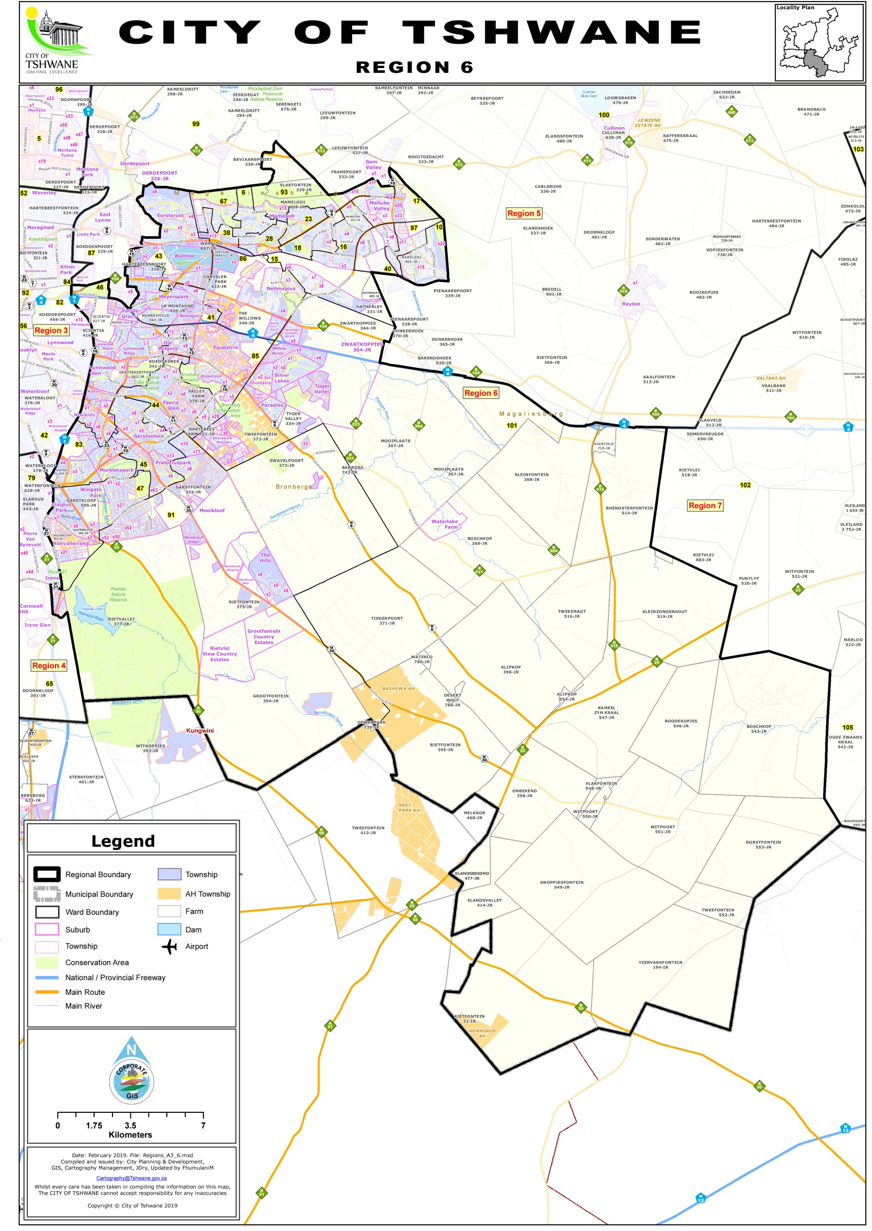
CBI Pretoria East – Demographics

Slide 20
Local population growth
2011 Census (Adjusted 2013 & 2016)
Ward | Year | Population | Area (km2) | Households | Persons/household | Persons/km2
44 | 2013 | 20537 | 8,90 | 8386 | 2,45 | 2307,53
45 |  | 18202 | 8,90 | 6558 | 2,78 | 2045,17
46 |  | 20701 | 18,10 | 8124 | 2,55 | 1143,70
47 |  | 21789 | 13,90 | 8070 | 2,70 | 1567,55
83 |  | 13283 | 8,00 | 5063 | 2,62 | 1660,38
85 |  | 24846 | 13,90 | 10343 | 2,40 | 1787,48
91 |  | 36303 | 171,00 | 13697 | 2,65 | 212,30
101 |  | 30368 | 557,90 | 11541 | 2,63 | 54,43
Total | 2013 | 186029 | 800,60 | 71782 | 2,59 | 232,36
 | 2019 | 213028 | 800,60 | 84234 | 2,53 | 266,09
 | 2021 | 222873 | 800,60 | 88848 | 2,51 | 278,38
 | 2024 | 238498 | 800,60 | 96246 | 2,48 | 297,90
Growth Rate = 2,3%/a
To be updated with the 2022 census data and projections to 2030

Slide 21

Region 6: Spatial Development Framework
2018 (To be updated 2023)
https://e-gis002.tshwane.gov.za/E_GIS_Web/

Slide 22
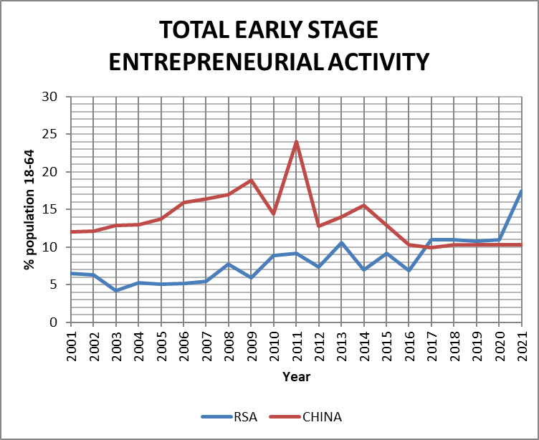
GEM Reports: % TEA
17,5% Active
in start-ups
after COVID

Slide 23
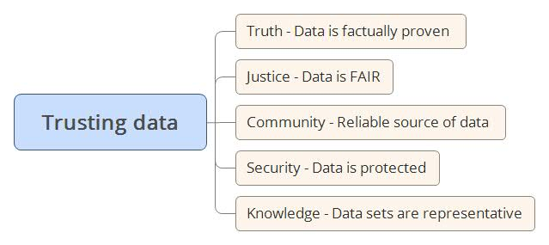
Conclusion
There are increasing volumes of unreliable information based on decreasing sets of quality data. Quality data is a national asset that should be protected much better. It is in the interest of your business and personal life to check the factual base of information received before making decisions based on the information.

